Slide 1

Predict on whether an individual has received a H1N1 flu vaccine - Binary Classification
Jinlun Zhang 20055835
Wenqi Tang 20093622
Eissa Khan 20082302

Slide 2
Problem Definition
The problem we attempt to address can be summarized to using machine learning strategies to predict on whether an individual has received a H1N1 flu vaccine or not based on his/her collected personal characteristics
A binary classification machine learning task.

Slide 3
Originality of contribution
We will train and compare three unique machine learning or deep learning models on this classification task, and implemented the stacking ensembling strategy on the 3 three models to obtain the optimal final prediction accuracy
Use unique combination of pre-processing techniques (such as oversampling and count rank encoding) to let the model better capture the patterns within the dataset and so learn more from the data to produce a satisfactory classification result

Slide 4


EDA

Slide 5
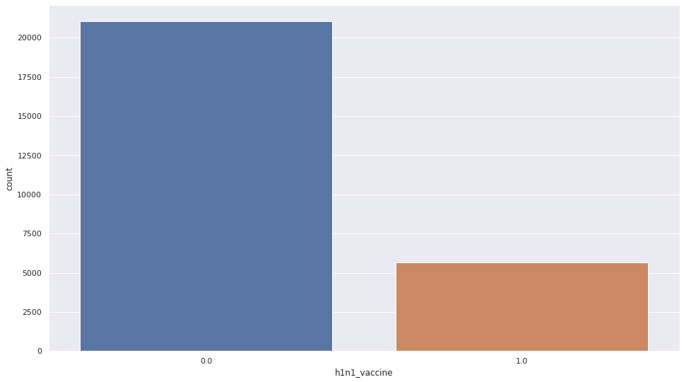
EDA (Target Attribute)
Moderately imbalanced
Ideal model evaluation metrics for our model should be F1 score or AUC score or both.
To address this imbalance, we will employ the oversampling strategy in the data-preprocessing section to balance the imbalanced number of records in each of the target class.

Slide 6
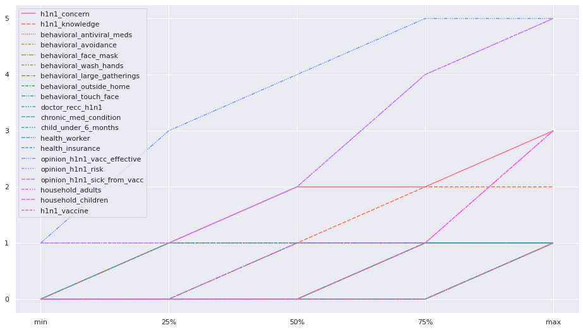
EDA (Numeric Attributes)
The provided numeric features are either binary numeric data or categorical ordinal numeric data
Numeric feature values are discrete, and their maximal values are below or equal to 5
As a result, no numerical data transformation like scaling may be necessary for this dataset, because the scale of each numeric feature is similar to each other, while we want to preserve the ordering within the categorical ordinal numeric features.

Slide 7
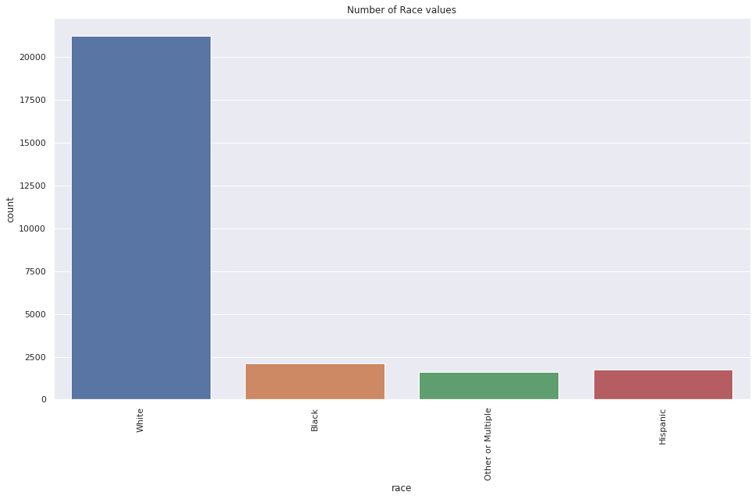
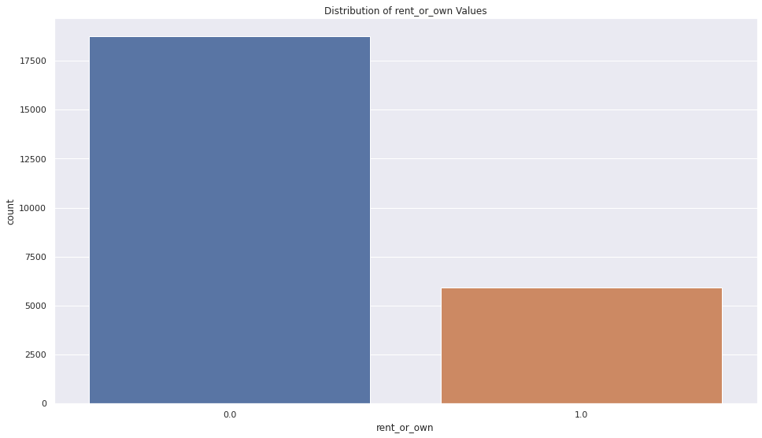
EDA (Categorical Attributes)
For certain categorical features, they may not provide much information to train the model as certain feature values dominate
Challenge: What strategy to convert those features into numeric with maximal originality preserved (no intrinsic ordering or info loss)

Slide 8

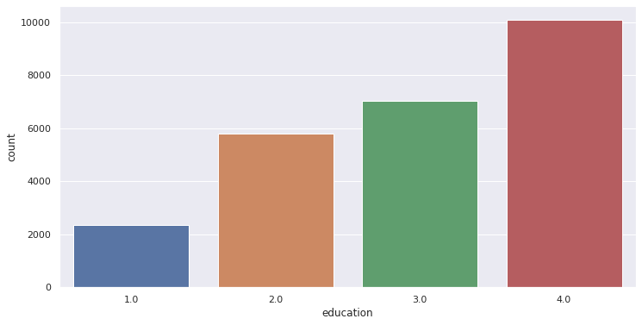
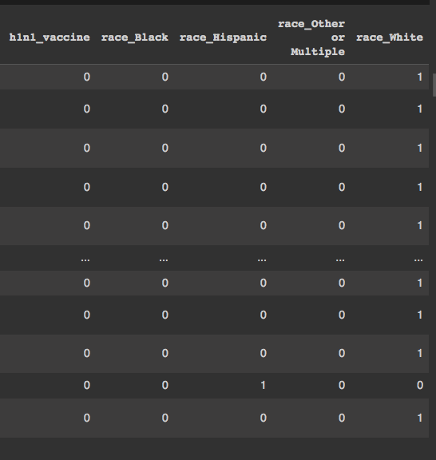
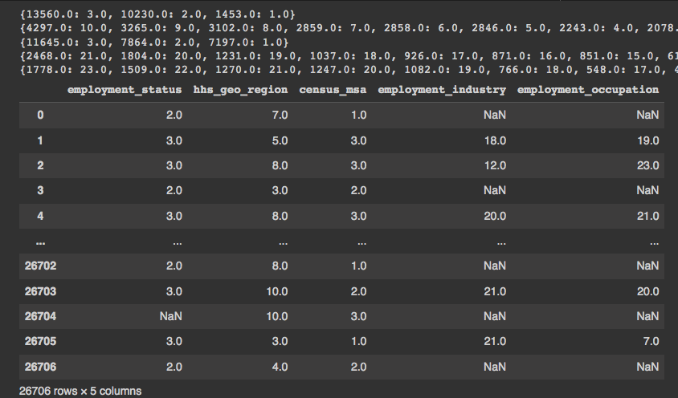
Data Preparation (Categorical Attributes)
Ordinal Encoding for features that has intrinsic ordering, such as 'Education' and 'Income'
One-Hot Encoding for binary features and the features without intrinsic ordering (like the feature 'rent_or_own' and 'race')
Count Rank Encoding for the features that do not have intrinsic ordering and have more than 10 unique values (like the feature 'hhs_geo_region') -> Dimensionality explosion if use one-hot encoding

Slide 9
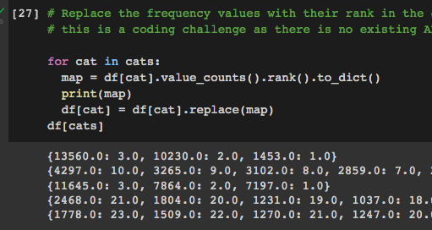
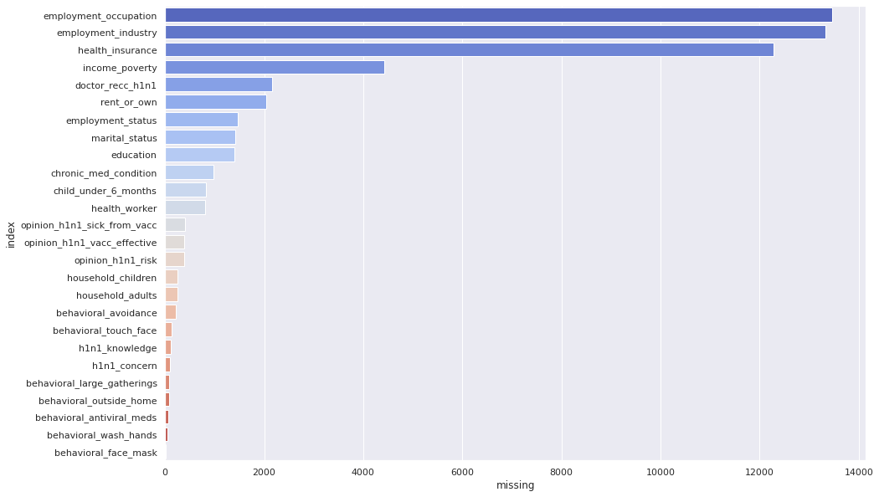
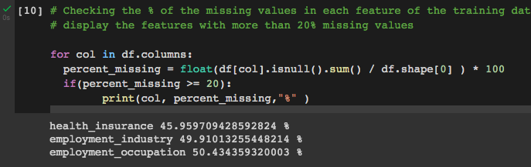
Data Preparation (Challenge)
No Existing API for Count Rank Encoding -> Have to write our own code
Handling missing values in features with around 50% missing values -> Cannot Drop them. Cannot use statistical filling. So k-mean imputer to fill in the missing values to avoid overrepresented values.

Slide 10
Oversampling
Why oversampling? The target attribute (‘h1n1_vacine’) is heavily imbalanced with the vaccinated group containing less than 25% of the data.
To remedy this, we chose to oversample the data using random oversampling.
The result? New rows were added to the data by choosing random rows from the vaccinated group (with replacement) until the two groups have equal number of rows.
The SVM validation AUC improves from 64.6% to 75.7%
The Stacking Ensembling AUC improves from 84.6% to 95.2%

Slide 11
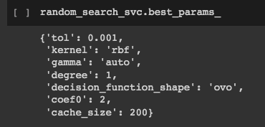

Model Training: Kernel SVM
Baseline model (Fewer hyper-parameters for tuning. Simple to implement. Less training time needed to give an impression about the complexity of the classification task)
Random Search CV to find a possibly satisfactory set of hyper-parameters by trying some random combinations out of the predefined ranges of hyper-parameter values
Final Validation AUC: 75.7% , Final Validation F1: 75.6%
Fun Fact: The f1 and AUC scores are only 0.78 and 0.5 when only the count encoding strategy is used, meaning we have achieved much better model performance by simply using the count rank encoding strategy, proving the wisdom of our Prof dropped in EDA presentation
Use Count Rank. Highly recommended

Slide 12
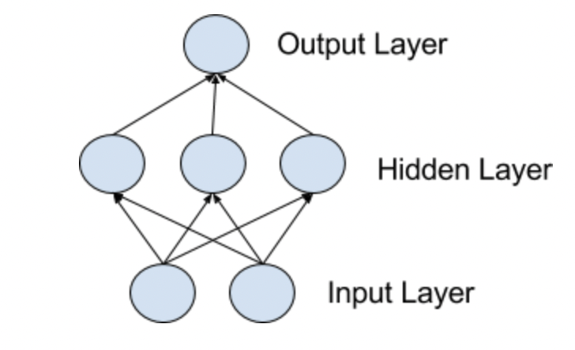
Train the Multilayer Perceptron (MLP)
Reason:
It is suitable for tabular data set
Non-linear models can be learned and can be learned in real time
Model Structure and Tuned Hyper-Parameter:
Use random search CV to find local optimal hyper-parameter
Use trial-and-error to find the optimal model structure with a good balance between the model training efficiency and the accuracy
Result:
Good accuracy and acceptable training time with 3 hidden layers (with descending nodes towards the output layer)
Validation auc: 75.8%, Validation F1: 75.8%

Slide 13
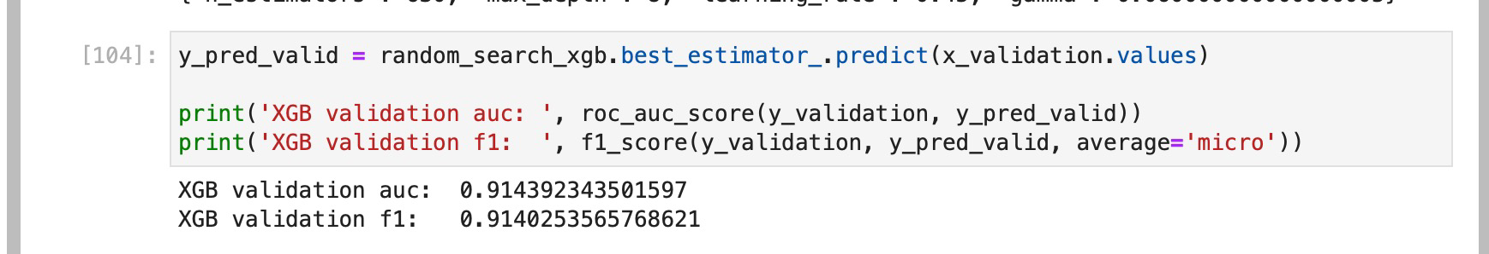
Deploying & Training – XgBoost
Xgboost is typically the best for tabular data with mixed data types (nominal and categorical).
Xgboost is an improvement on Decision Trees. Decision Trees are constructed greedily and a single tree is constructed to fit the training data.
Xgboost is an ensemble technique that iteratively constructs decision trees on the residuals in errors from prior trees.
For hyperparameter search, random search was performed and evaluated against cross validation.
Xgboost performed the best overall with AUC & F1 scores above 91%. As illustrated in the model performance image.

Slide 14
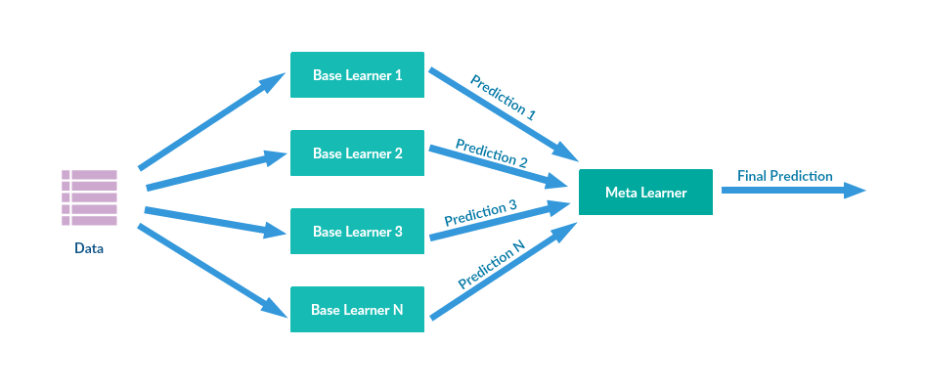
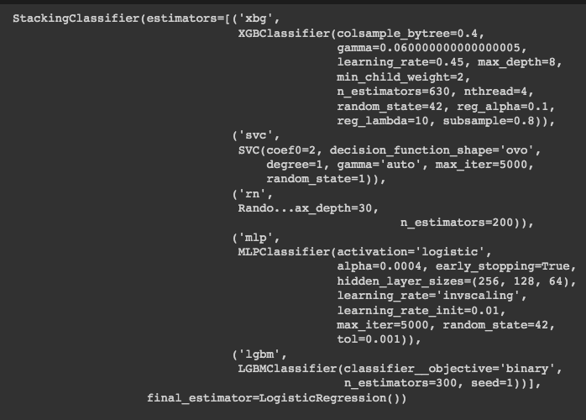
Ensembling Strategy: Stacking
Use Stacking Ensembling Strategy to combine the models we trained together to produce more educated final predictions
2 Additional Models are added in the stacking in attempts to get better results:
Random Forest
LightGBM classifier
Final Stacking Validation AUC: 95.2%
Final Stacking Validation F1: 95.2%

Slide 15
Future Works
Use external dataset to enlarge the existing training dataset to get more variance and more patterns
Use the cloud computing resources to train more models with more time to get better performance
Use more diverse ensembling strategies and regularizations to avoid potential overfitting

Slide 16
Thank you
Jinlun Zhang
Wenqi Tang
Eissa Khan

